Slide 1

Prospects for uses of generative AI in evaluations of truth and causality
Jeff Colombe, Ph.D., Principal Scientist
The MITRE Corporation jcolombe@mitre.org
15 Nov 2023
© 2023 The MITRE Corporation | All Rights Reserved | Approved for Public Release 23-00371-17. Distribution Unlimited.
Notes:
I'm trained as a biomedical scientist and a cognitive scientist, and you'll see elements of both in this presentation. While I've worked in biotech, I've spent probably more time in computer vision and data analytics for public health. So I'll talk about cognition and learning across these fields, and invite you to use your imagination in how to relate some of the ideas to biotech.

Slide 2
Technical Exchange Meeting hosted at MITRE, 27 Jun 2023
“Opportunities for Generative AI in Biotechnology”
Attended by industry (e.g., Aaron), academia, and government
White paper summarizing TEM and parallel literature review, with a focus on potential for such emerging tools to impact progress in biotechnology based on their abilities to compose novel content, to engage in meaningful and informative dialogue with a human, and to explain ideas.
Current state of practice: Generative AI is currently being developed to design biological products with desired properties, to map knowledge in the field, to serve as research assistants with a conversational interface.
Hallucination: Current large language models (LLMs) hallucinate plausible but nonexistent content such as statements about facts and authoritative citations, and have no means to discriminate truth value from creative synthesis of content derived from statistical patterns in training data.
© 2023 The MITRE Corporation | All Rights Reserved | Approved for Public Release 23-00371-17. Distribution Unlimited.

Slide 3
Applications of interest in biotechnology and beyond
Predictive design of molecules and retro-biosynthetic pathways, and predictive design of larger systems from tissues to organs to whole organisms
Conversational scientific assistant software
Automatic scientometric analysis of knowledge expressed in the research literature
  Summarizing and interpreting literature findings, tracking knowledge trends
  Automating aspects of domain ontology curation and topic mapping (e.g., extending the MeSH taxonomy)
  Identifying uncertainty, controversy, and hypotheses worth investigating
Automatic development of theoretical causal models of natural processes from scientific data and literature (e.g., DARPA Big Mechanism program)
© 2023 The MITRE Corporation | All Rights Reserved | Approved for Public Release 23-00371-17. Distribution Unlimited.

Slide 4
Detour: Large Language Model (LLM) basics
Transformer neural networks are trained to predict word sequences
Instruction tuning (treat input as instructions, respond appropriately)
Value alignment (improve responses to align with human feedback on the “goodness” of replies)
Fine-tuning (further train a pre-trained LLM in a domain, e.g., BioGPT, Luo et al., 2023)
Retrieval augmentation (expose a pre-trained LLM to custom prompt data, Lewis et al., 2020)
Avoid overfitting (meaning, avoid copying source training data verbatim in responses, may not be ideal for many science and engineering applications)
Major recent advances were partly due to the prodigious scale of training data and high-performance computing (HPC) resources used to perform training (e.g., all English language Internet pages)…the “large” in large language models, $100M pricetag
© 2023 The MITRE Corporation | All Rights Reserved | Approved for Public Release 23-00371-17. Distribution Unlimited.

Slide 5
Toward trustworthy and explainable AI in scientific research and engineering
Keep the “creative” (generative, synthetic) abilities while curbing adverse hallucinations
Train models to be truth-generating, not just statistics-generating:
  Use consensus or “gold standard” human curation of certain training content (expensive, but can be crowd-sourced, e.g., iNaturalist computer vision app for identifying flora and fauna)
  Mark authoritative sources prior to training and allow verbatim citations of training data where appropriate (runs against urges to avoid overfitting of source material in responses)
  Provide linguistic representations with sensory and/or motor meaning using multimodal models
  Train models to expose the chains of reasoning used to generate outputs
  Develop “intrinsic cognitive models” that seek to optimize scale-model likeness of structure and function with the phenomena under study for accurate prediction and causal inference, with interpretability and explainability built-in
© 2023 The MITRE Corporation | All Rights Reserved | Approved for Public Release 23-00371-17. Distribution Unlimited.

Slide 6
Current efforts to improve trustworthiness and interpretability
Attributed question answering:
  PaperQA (Andrew White) is an example of a transformer-based LLM that advertises generating answers to questions, “…with no hallucinations, by grounding responses with in-text citations.” (https://github.com/whitead/paper-qa)
  Bohnet B et al. (2022) Attributed question answering: Evaluation and modeling for attributed large language models. arXiv:2212.08037v2 [cs.CL] Last revision 10 Feb 2023.
  Gao L et al. (2023) RARR: Researching and revising what language models say, using language models. Proceedings of the 61st Annual Meeting of the Association for Computational Linguistics Volume 1: Long Papers, pages 16477–16508. July 9-14, 2023.
Factuality detection:
  Chern IC et al. (2023) FacTool: Factuality detection in generative AI, a tool augmented framework for multi-task and multi-domain scenarios. arXiv:2307.13528v2.
Exposed chains of reasoning:
  Lu P et al. (2022) Learn to explain: Multimodal reasoning via thought chains for science question answering. The 36th Conference on Neural Information Processing Systems (NeurIPS), 2022.
© 2023 The MITRE Corporation | All Rights Reserved | Approved for Public Release 23-00371-17. Distribution Unlimited.

Slide 7
Limits of language for analysis and representation (why do we need multimodal models?)
Language is a form of synesthesia used for communication, and acts as a set of pointers to mental models that have substantial nonlinguistic content often referred to as mental imagery (Pearson and Kosslyn, 2015; Colombe et al., 2022)
Language is also frequently used to scaffold internal mental activity (via "self-talk"), but it is not necessary or sufficient for internal mental activity
Ordinal representational properties of language are quite low (the basis of the “Frame Problem” in cognitive science, e.g., Janlert, 1996)
Words bear very little likeness to the phenomena that they refer to, making them inadequate for intrinsic cognitive modeling (although onomonopoeitic words like “bang” and “pop” are exceptions)
Bender EM and Koller A (2020) Climbing towards NLU [Natural Language Understanding]: On meaning, form, and understanding in the age of data. Proceedings of the 58th Annual Meeting of the Association for Computational Linguistics, pages 5185–5198. July 5–10, 2020.
Dretske F (1983) Knowledge and the Flow of Information. MIT Press.
© 2023 The MITRE Corporation | All Rights Reserved | Approved for Public Release 23-00371-17. Distribution Unlimited.

Slide 8
Training multimodal AI models for biotechnology
We’d like to be able to have research conversations with AI…
...but also have AI generate novel content (e.g., generate 3D protein structures from gene sequences, then fit candidate drug molecules to active sites, then produce retro-synbio pathways to make the drugs, then engineer a microbe to house the metabolic synthetic pathways…e.g., a bug that makes Lipitor from acetate)
…and talk us through the whole thought process.
We can provide non-linguistic grounding for language through multimodal training
This allows reasoning over primary evidence, not just over commentary about it
A challenge is getting all non-language data into formats suitable for machine learning, and appropriately cross-referenced with linguistic mentions in literature (what proteomics database entries correspond to this passage of text?)
© 2023 The MITRE Corporation | All Rights Reserved | Approved for Public Release 23-00371-17. Distribution Unlimited.

Slide 9
Intrinsic cognitive models: What are they?
ICMs approximate structural and functional isomorphism with the system being modeled (e.g., phenomena in the world), with capture of causality / constraints from world data (Waskan J (2006) Models and Cognition. MIT Press.)
Learned ICM representations may be more interpretable and explainable than those from deep learning, but could be more flexible than hand-built ICM models
Let's look at some non-biotechnology variations (but use your imagination!), including hand-built physical, hand-built computational, and machine-learned...
© 2023 The MITRE Corporation | All Rights Reserved | Approved for Public Release 23-00371-17. Distribution Unlimited.
Notes:
https://www.wikihow.com/Draw-a-Floor-Plan-to-Scale

Slide 10
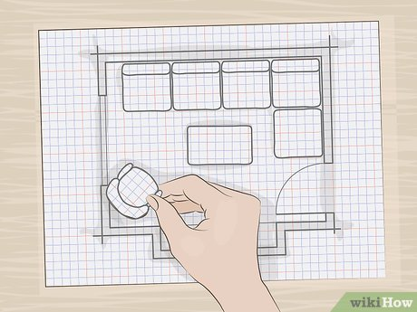
Intrinsic cognitive models: What are they?
ICMs approximate structural and functional isomorphism with the system being modeled (e.g., phenomena in the world), with capture of causality / constraints from world data (Waskan J (2006) Models and Cognition. MIT Press.)
Example: paper cutouts of furniture on a house floor plan on graph paper
Structure: shape, size
Function: rigidity, collision / no overlap, maybe also movement gaps
https://www.wikihow.com/Draw-a-Floor-Plan-to-Scale
© 2023 The MITRE Corporation | All Rights Reserved | Approved for Public Release 23-00371-17. Distribution Unlimited.
Notes:
https://www.wikihow.com/Draw-a-Floor-Plan-to-Scale

Slide 11
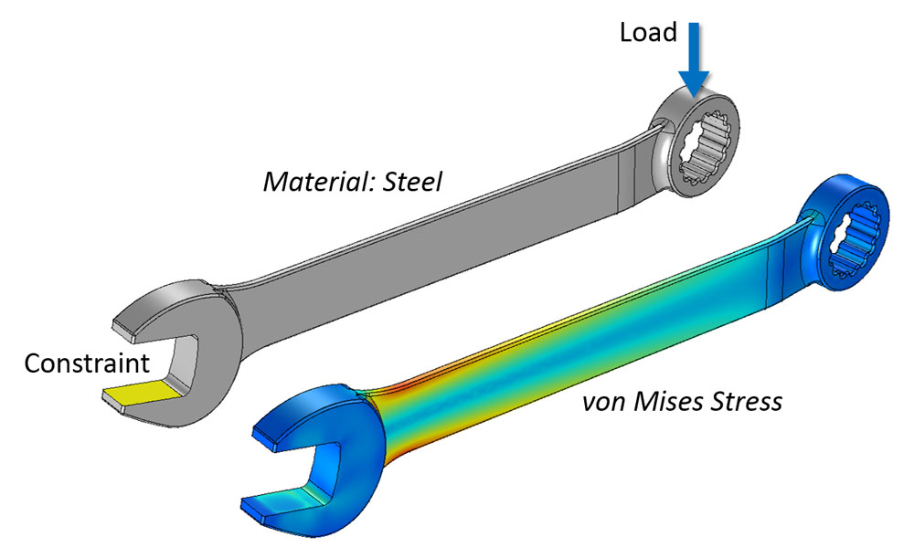
Intrinsic cognitive models: What are they?
ICMs approximate structural and functional isomorphism with the system being modeled (e.g., phenomena in the world), with capture of causality / constraints from world data (Waskan J (2006) Models and Cognition. MIT Press.)
Example: finite element models (shape, internal structure, viscoelasticity, forces, stresses, strains, fractures)
https://www.comsol.com/multiphysics/mesh-refinement
© 2023 The MITRE Corporation | All Rights Reserved | Approved for Public Release 23-00371-17. Distribution Unlimited.
Notes:
https://www.comsol.com/multiphysics/mesh-refinement

Slide 12
Intrinsic cognitive models: What are they?
ICMs approximate structural and functional isomorphism with the system being modeled (e.g., phenomena in the world), with capture of causality / constraints from world data (Waskan J (2006) Models and Cognition. MIT Press.)
How might we automate the learning of intrinsic cognitive models from data?
Example systems to consider modeling, to help us reason about the learning process: hinge door, sliding door, steering wheel (each rigid with one degree of freedom), lock and key, drug molecule and G-protein coupled receptor
Next, I’ll show you a rudimentary ICM using unsupervised learning
© 2023 The MITRE Corporation | All Rights Reserved | Approved for Public Release 23-00371-17. Distribution Unlimited.

Slide 13
How can we model causes, and use them to make inferences?
Many ways of making predictions are hard-coded in terms of known variables and unknown variables
This is the stuff of supervised learning: one-way question-and-answer machines
Q: What if we can’t know in advance which variables are known or unknown? “MacGyver moment”
A: Maybe we can use nonparametric unsupervised learning in a creative way to generate/predict dynamically unknown variables given dynamically known variables in a kind of “dynamic runtime regression”
Objective: learn about the latent causes behind the patterning that is seen in training data, then use those causes to make predictions
© 2023 The MITRE Corporation | All Rights Reserved | Approved for Public Release 23-00371-17. Distribution Unlimited.

Slide 14
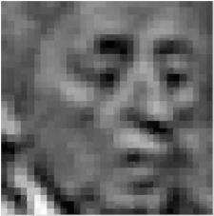

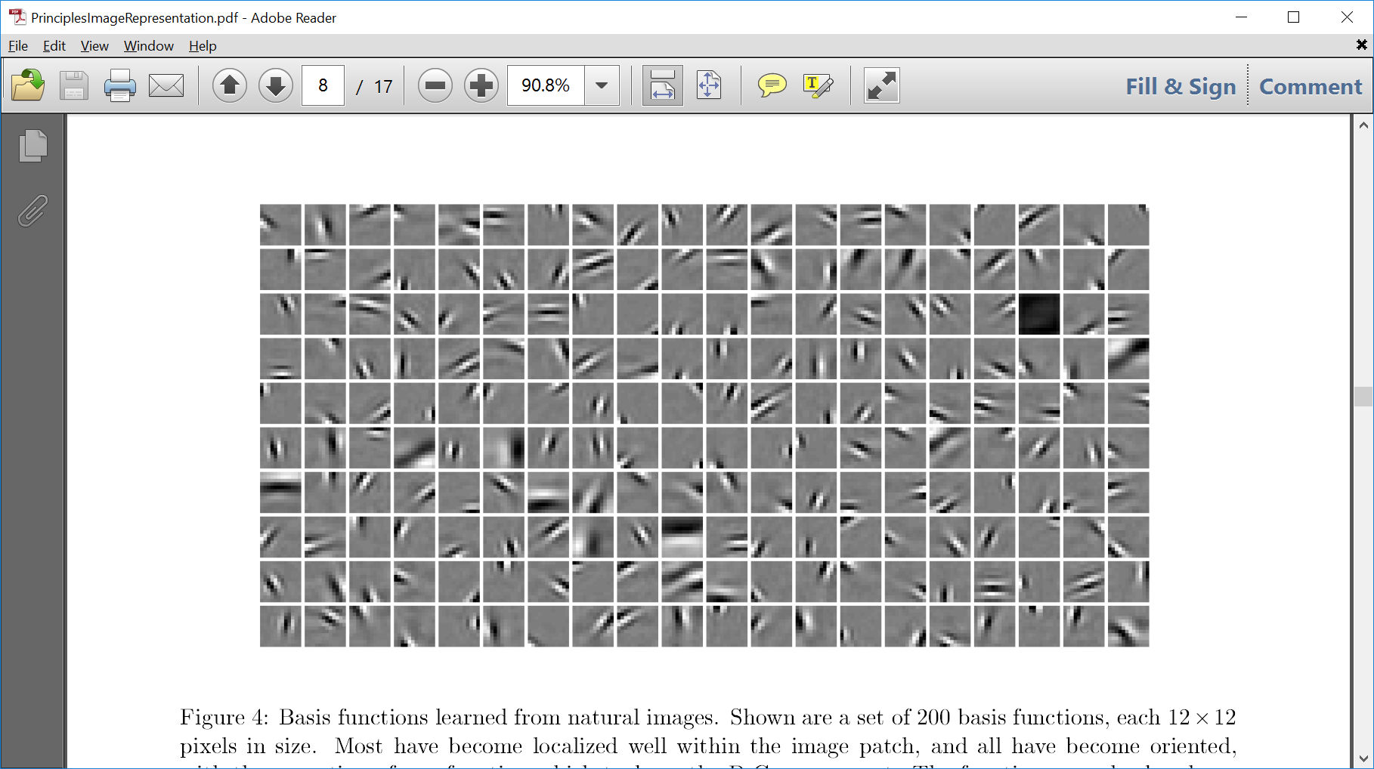
Using an unsupervised learning method to develop sparse pattern-based interpretations of natural images (looking for putative image causes)
Generative
reconstruction
Novel image
Learned image causes
from a large set of
image training data
(generative basis set)
NOTE: This method
isn't specific to vision
or pixels...these inputs
are unlabeled
© 2023 The MITRE Corporation | All Rights Reserved | Approved for Public Release 23-00371-17. Distribution Unlimited.

Slide 15
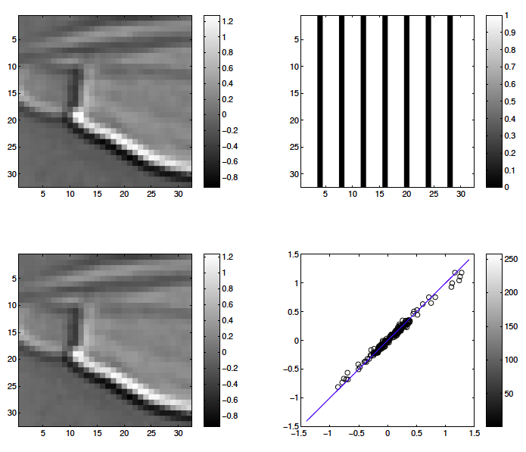
Using an unsupervised learning method to perform dynamic inference when ‘known’ and ‘unknown’ labels are not available during training
Drive
model
using
‘knowns’
A
B
Mask with white pixels = ‘knowns’
and black pixels = ‘unknowns’
Novel natural image
C
D
Reconstruction
Error (diagonal is best fit)
Generate
whole
image
Learned image causes
(generative basis set)
© 2023 The MITRE Corporation | All Rights Reserved | Approved for Public Release 23-00371-17. Distribution Unlimited.

Slide 16
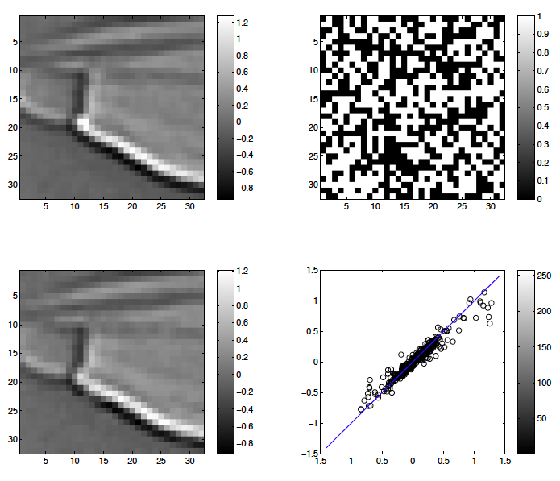
Using an unsupervised learning method to perform dynamic inference when ‘known’ and ‘unknown’ labels are not available during training
Drive
model
using
‘knowns’
A
B
Mask with white pixels = ‘knowns’
and black pixels = ‘unknowns’
Novel natural image
C
D
Reconstruction
Error (diagonal is best fit)
Generate
whole
image
Learned image causes
(generative basis set)
© 2023 The MITRE Corporation | All Rights Reserved | Approved for Public Release 23-00371-17. Distribution Unlimited.

Slide 17
How can we model causes, and use them to make inferences?
Let’s not be too literal about this example…
You may not need to generatively predict left-out variables in images
But you may have datasets with unexpected missingness (mention MICE)
An unsupervised learning model of putative causes of joint data may help you to dynamically infer missing variables without the limitations of supervised learning
Does this count as an intrinsic cognitive model?
Arguably, yes
The learned “causes” don’t need to pass hard tests. They can be putative, approximate, latent, and continuum (meaning not nameable or categorical) in nature. We might think of them as tentative micro-theories about why observations are ordered the way that they are observed to be. Other uses...
© 2023 The MITRE Corporation | All Rights Reserved | Approved for Public Release 23-00371-17. Distribution Unlimited.

Slide 18
Evaluations of claims of causality from evidence
In science, we're often concerned with causality, and we've been talking about it...
Judea Pearl and colleagues (2009) proposed a “causal ladder” for evaluations of causal influence from evidence
Prediction uses co-occurrence of observations in joint data (e.g., “Buildings can become damaged during earthquakes”), weakest claims, typical of passive observation
Intervention involves manipulating some observable variables to determine resulting changes in others (e.g., “Forces typical of earthquakes can cause damage to materials and structures typical of buildings”), stronger claims, typical of laboratory or controlled field research
Counterfactual claims are strongest, and involve imagining other causes with other causal outcomes (e.g., “If there had been no earthquake, this building would not have been damaged”), requires theoretical modeling and “parallel universe” reasoning
Such analytic goals may be used as objectives for tuning machine learning models
© 2023 The MITRE Corporation | All Rights Reserved | Approved for Public Release 23-00371-17. Distribution Unlimited.

Slide 19
How can we use machine learning to model counterfactuals?
Sometimes you can’t do a randomized controlled trial (RCT)
Maybe you can do an intervention and see what happens
You might be able to model the trend in data prior to your intervention, and extrapolate from the trend as a counterfactual to compare to what happened after your intervention
Modeling causal components of a dataset, and considering what would happen if a component were to be removed…
Note that the following example is parametric and uses supervised learning (!)
© 2023 The MITRE Corporation | All Rights Reserved | Approved for Public Release 23-00371-17. Distribution Unlimited.

Slide 20

© 2023 The MITRE Corporation | All Rights Reserved | Approved for Public Release 23-00371-17. Distribution Unlimited.

Slide 21
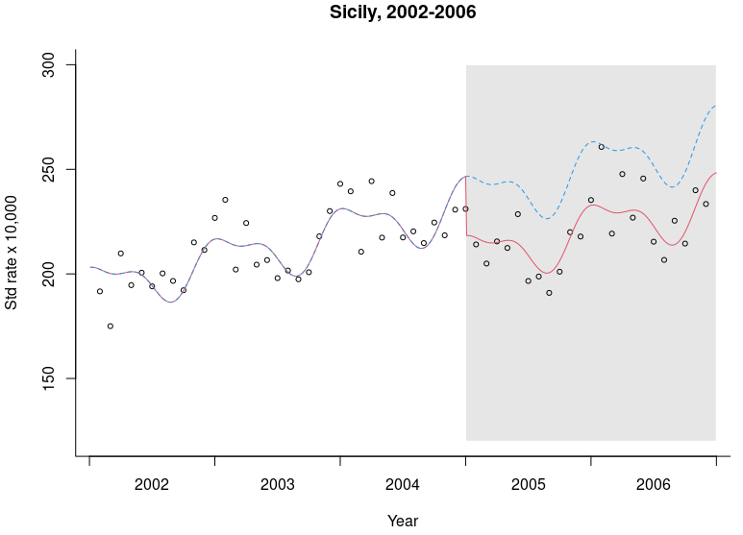
Emergency
Department
admissions for
acute coronary events
(~heart attacks)
Trend prior to
public smoking ban
Public smoking ban
© 2023 The MITRE Corporation | All Rights Reserved | Approved for Public Release 23-00371-17. Distribution Unlimited.

Slide 22




Time series analysis tutorial article: Regression equation
$Y_{t}=β_{0}+β_{1}T+β_{2}X_{t}+β_{3}\left(T−T_{0}\right)X_{t}$
Flat baseline (Y-intercept)
$$β_{0}∗1.0$$
Time series (months)
Slope of trend over time
$$β_{1}∗T$$
Time series (months)
Level change due to intervention (smoking ban, in this case)
$β_{2}∗X_{t}$ (0,1)
Time series (months)
© 2023 The MITRE Corporation | All Rights Reserved | Approved for Public Release 23-00371-17. Distribution Unlimited.

Slide 23
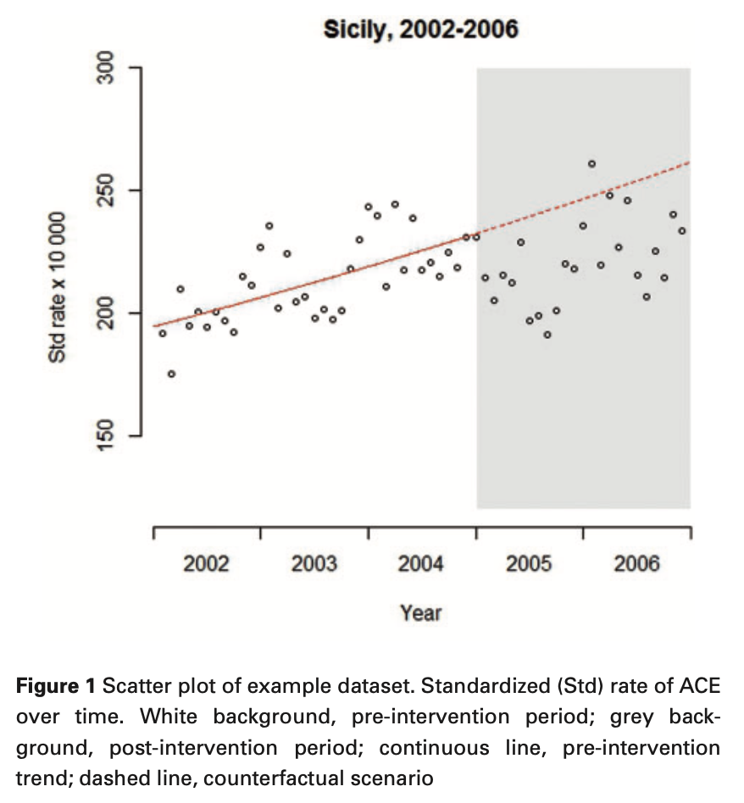

Time series analysis tutorial article: Figure 1
$$Y_{t}=β_{0}+β_{1}T+β_{2}X_{t}+β_{3}\left(T−T_{0}\right)X_{t}$$
0.005
-6.243
© 2023 The MITRE Corporation | All Rights Reserved | Approved for Public Release 23-00371-17. Distribution Unlimited.

Slide 24
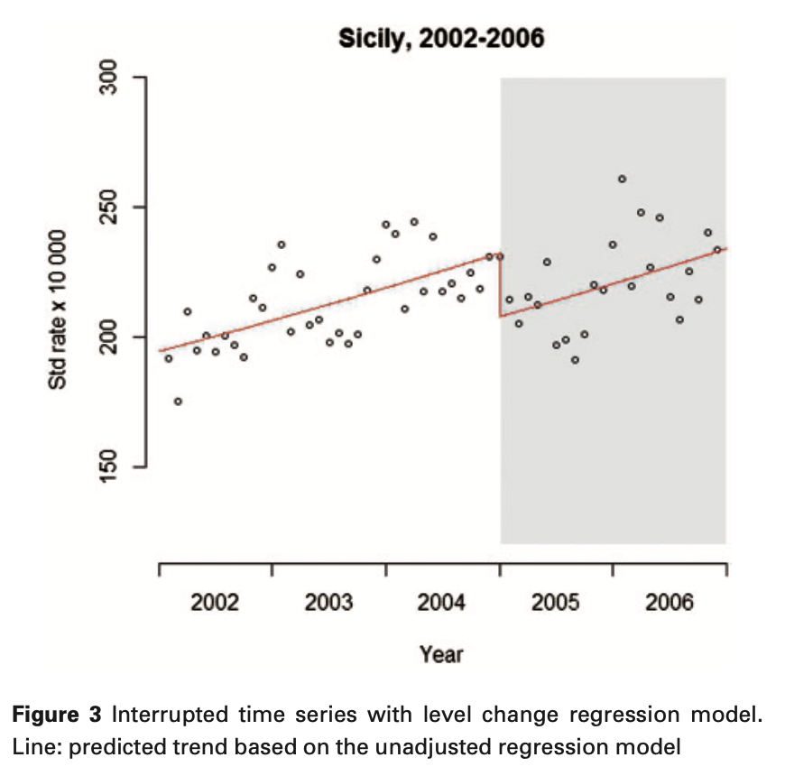

Time series analysis tutorial article: Figure 3
Effect:
11.2% immediate reduction in heart attacks (relative rate is 0.894)
95% confidence interval is 0.864 to 0.925
P < 0.001
$$Y_{t}=β_{0}+β_{1}T+β_{2}X_{t}+β_{3}\left(T−T_{0}\right)X_{t}$$
-0.112
0.005
-6.243
© 2023 The MITRE Corporation | All Rights Reserved | Approved for Public Release 23-00371-17. Distribution Unlimited.

Slide 25
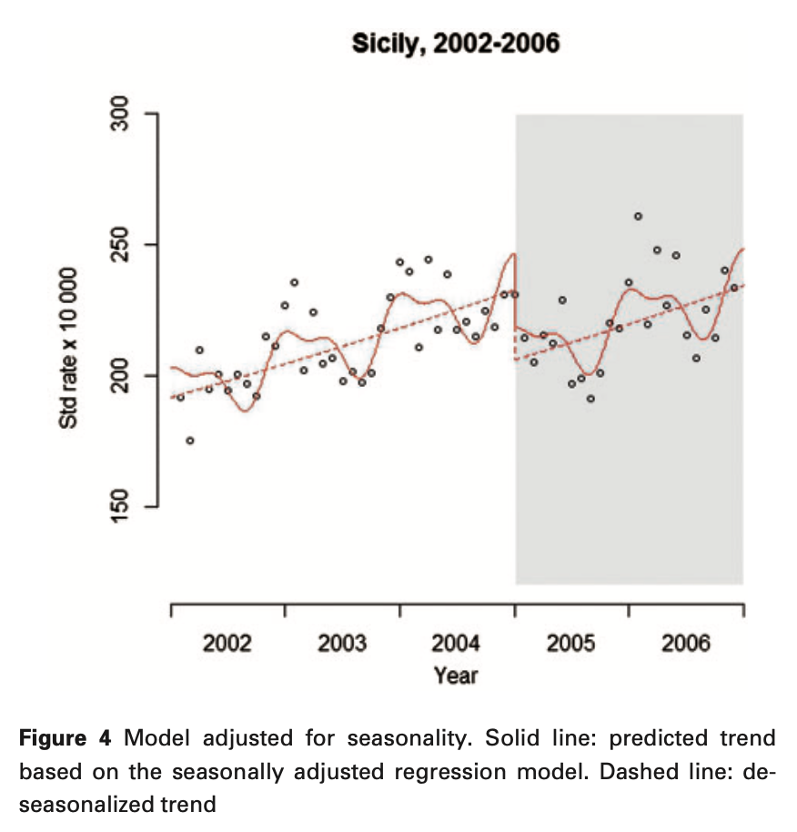
Time series analysis tutorial article: Figure 4
Effect:
13% immediate reduction in heart attacks (relative rate is 0.885)
95% confidence interval is 0.839 to 0.933
P < 0.001
$$Y_{t}=β_{0}+β_{1}T+β_{2}X_{t}+β_{3}\left(T−T_{0}\right)X_{t}$$
NOTE: Seasonal harmonics are
not shown in the equation.
© 2023 The MITRE Corporation | All Rights Reserved | Approved for Public Release 23-00371-17. Distribution Unlimited.

Slide 26
Time series analysis tutorial: My custom plot of the counterfactual
Are these significantly different?
Counterfactual
P < 0.001
Intervention
© 2023 The MITRE Corporation | All Rights Reserved | Approved for Public Release 23-00371-17. Distribution Unlimited.

Slide 27
Thank you!
© 2023 The MITRE Corporation | All Rights Reserved | Approved for Public Release 23-00371-17. Distribution Unlimited.

